Slide 1
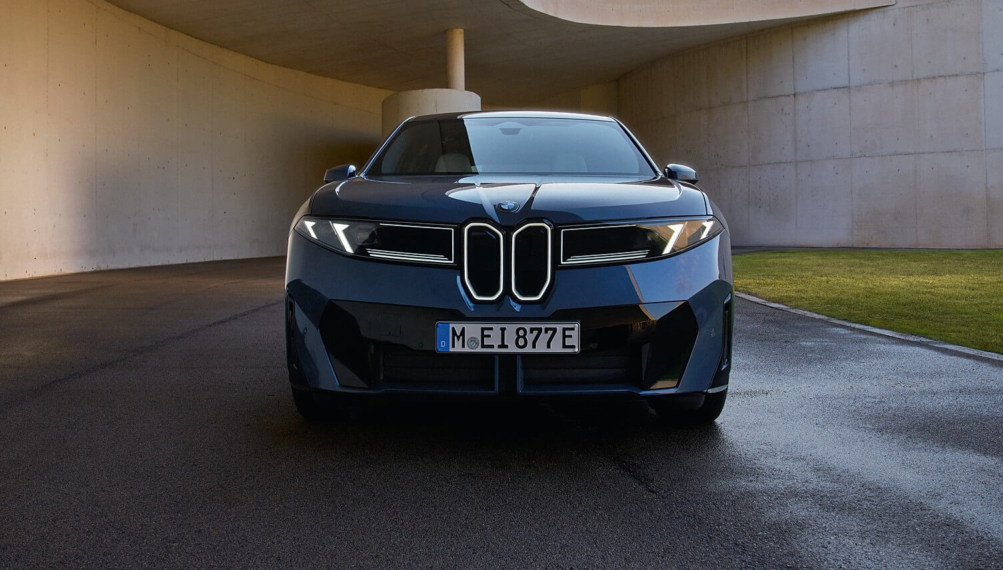




Ideal Route Projection (IRP)
Asad Melibaev, Lev Oleynik, Enoch Shen, Drew Hering

Slide 2
Weeks 1
Date: January 5th to January 11th

Slide 3
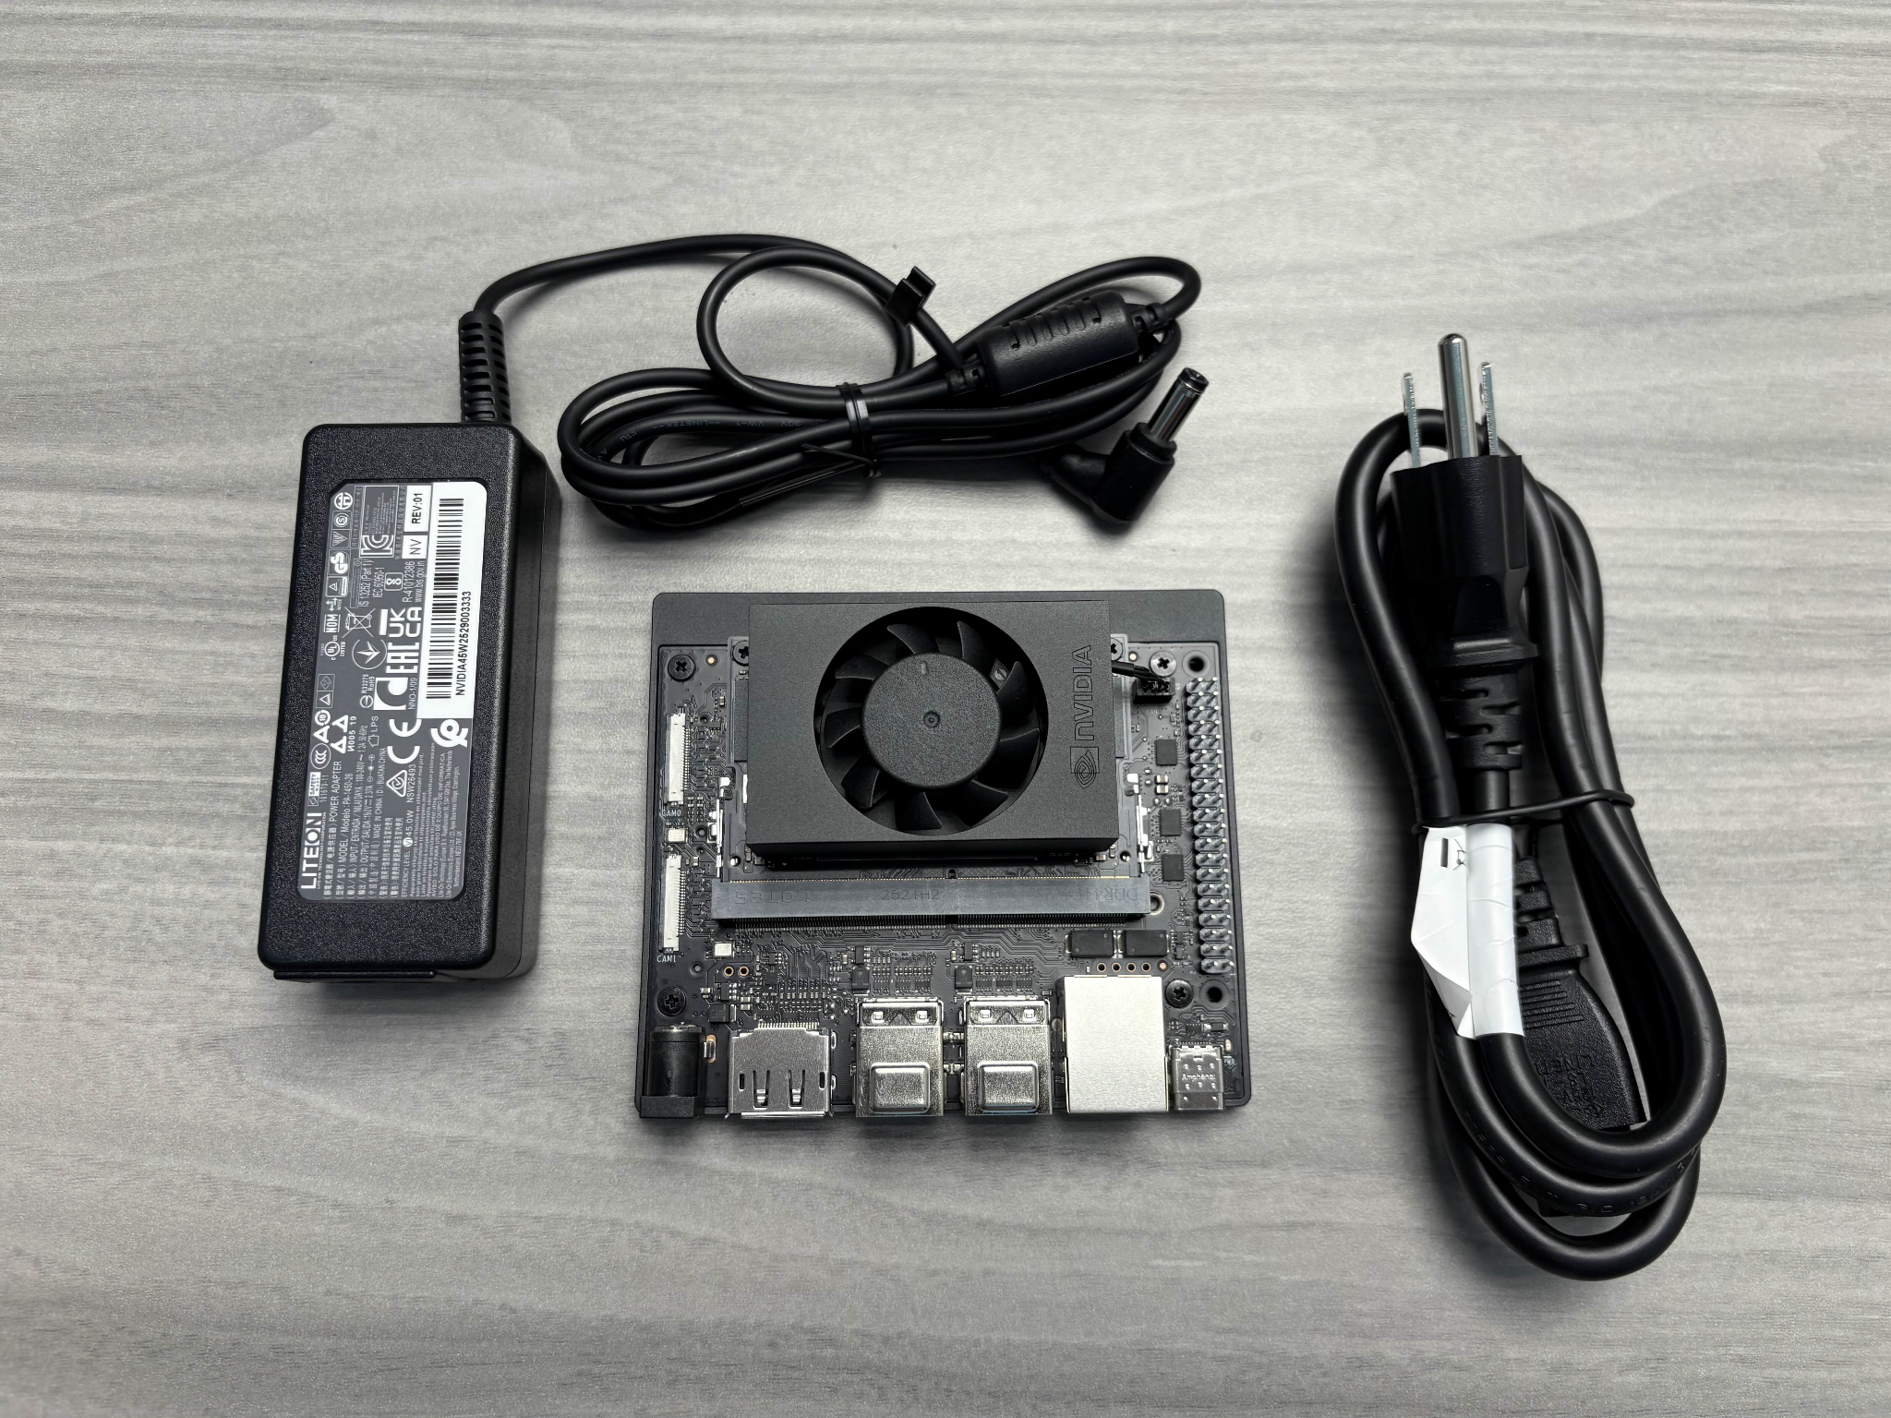
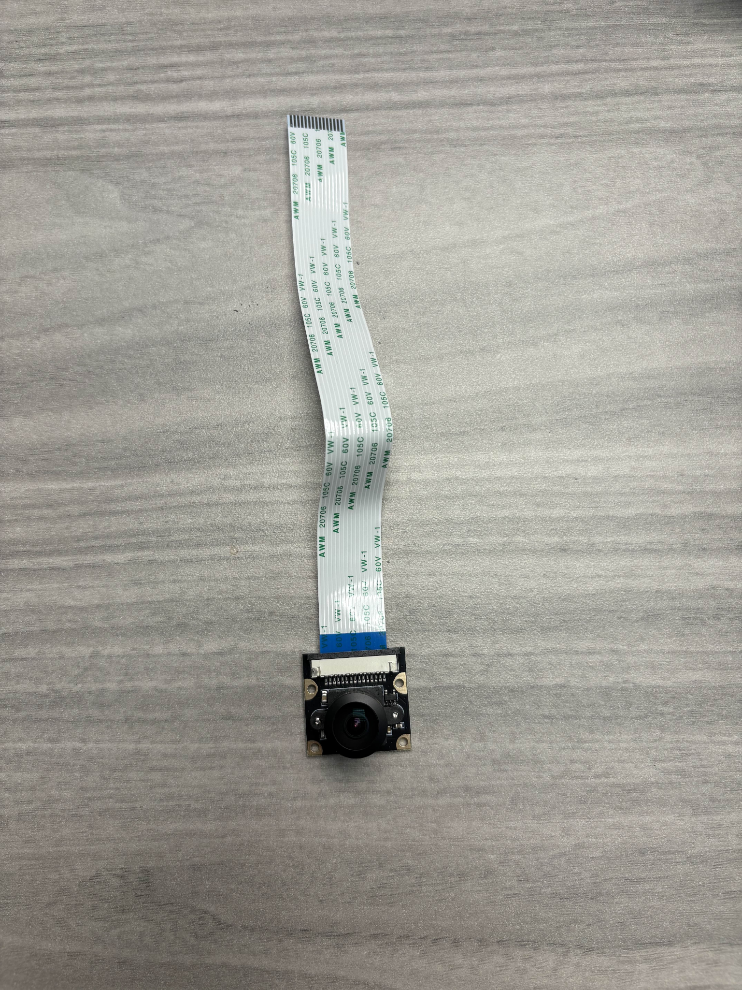
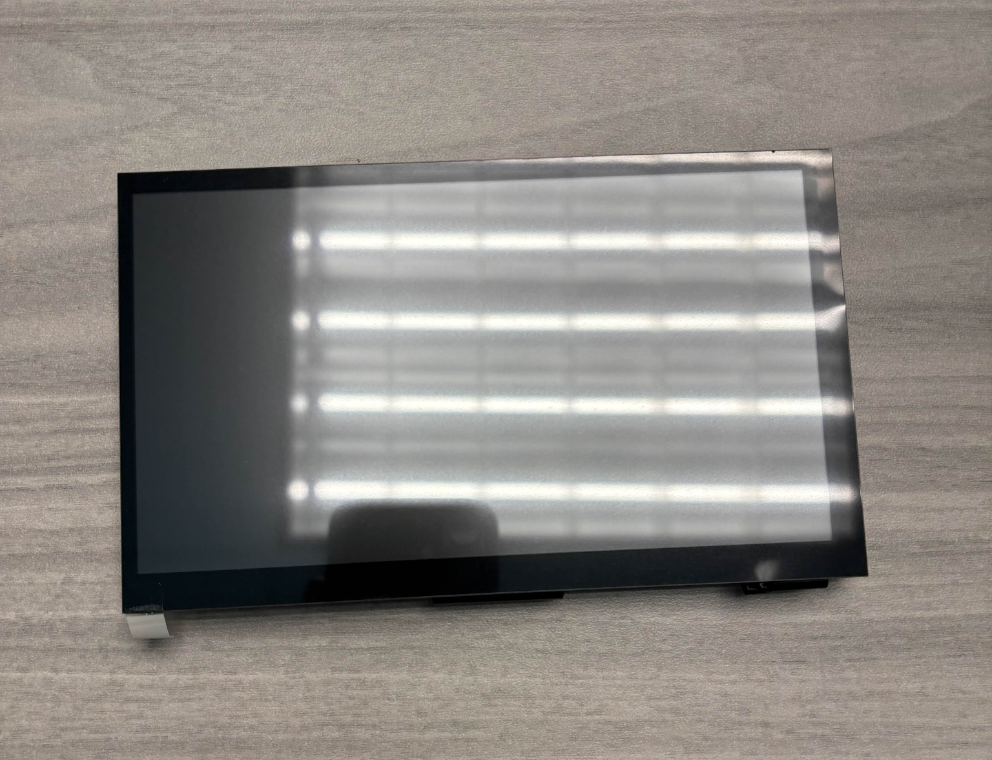
What have done this week (Overview)
Purchased and tested devices
Jetson Orin Nano Developer Kit
IMX219-160 Camera
LCD Display 7IP-Cap LCD
Installed OS
Jetpack 6.2.1
Setup a consistent meeting time and place for winter quarter ‘26.

Slide 4
Weeks 2
Date: January 12th to January 19th

Slide 5
What have done this week (Overview)

Slide 6
To-do list for next week
(Asad Melibaev):
Write the algorithm to find a trajectory that avoids the pothole or the XY area that Drew will calculate
(Lev Oleynik):
Add progress to GitHub (Add pictures, list hardware, existing code from last quarter)
Research state of the art AI models that can run on Jetson Orin Nano Developer Kit 8GBs
Ability for segmentation not just identification, display other cars, traffic lanes, potholes.
(Enoch Shen)
Update Slide Winter quarter
Create an animatable visual overlay on camera feed with C++ (ideal route, steering wheel, arrow, text)
(Drew Hering):
Determine the what other hardware we might need (cables, adaptors, sensors, etc.)
Improve steering angle sensor with Kalman Filter + GPS

